Slide 1
PBDA PROJECT
Richanshu Jha (rj1469@nyu.edu)
Aishwarya Kore (adk497@nyu.edu)
Sanjana Jangnure (sbj286@nyu.edu)
Tejas Shetty (trs389@nyu.edu)

Slide 2
Problem Statement
Problem: Predict the purchase amount of products THAT THE CUSTOMERS ARE WILLING TO PAY to obtain maximum profit during black Friday sales based on various attributes of customer like age, gender, occupation, city category, marital status and product attributes like product categories and product prize.

Slide 3
Dataset description
The dataset comprises of sales transactions captured at a retail store. It’s a classic dataset for understanding multiple shopping experiences. The dataset has 550,069 rows and 12 columns.
User_ID | Product_ID | Gender | Age_label | Age | Occupation | City_Category | stay_in_label | Stay_In_Current_City_Years | Marital_Status | Product_Category_1 | Product_cat2_label | Product_Category_2 | Product_cat3_label | Product_Category_3 | label
User_ID | Product_ID | Gender | Age | Occupation | City_Category | Marital_Status | Product_Category_1 | Product_Category_2 | Product_Category_3 | purchase
*dataset taken from https://datahack.analyticsvidhya.com/contest/black-friday/

Slide 4



ARCHITECTURE SCALING
Vendor Database
( SQL, Teradata, Oracle )
S3 Landing Layer ( Flat Files loaded weekly)
S3 Unified Layer
( Tables with preprocessed data
S3 Integration Layer
S3 Publish Layer
Apache Spark
Initial Preprocessing involves data cleaning and standardization
ML Algo intermediate tables are in Integration layer and final output is in Publish layer
Viz Tools like Tableau, Spotfire

Slide 5
APPROACH
ETL –
Transform the data by replacing null values in some columns(product_category) by 0
Modify the data that is ambiguous to fit into a category like stay_in_currentcityyears- +4 can be changed to 4
Typecasting values to their correct datatypes e.g change Product_id, city_Category,Gender to integer from string
Drop the features like Product_Category_2, Product_Category_3 that have distribution where max number of values are null because this makes our data skewed and may affect our final prediction.

Slide 6
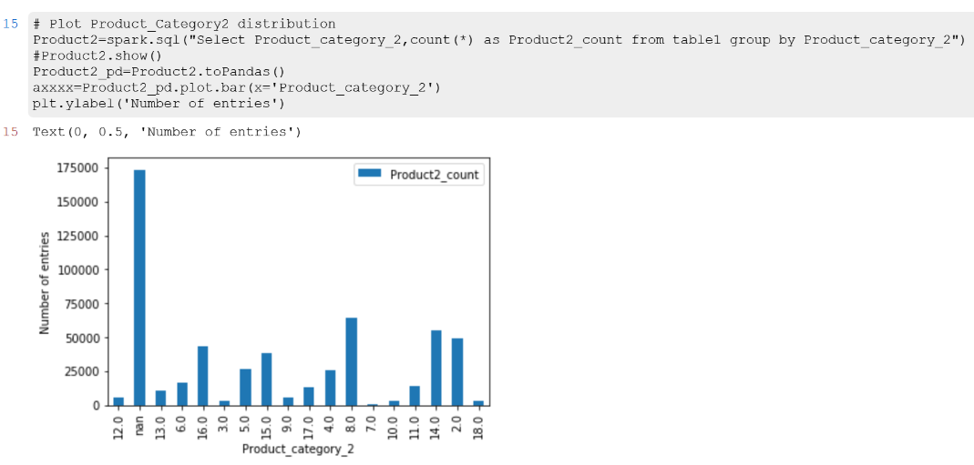
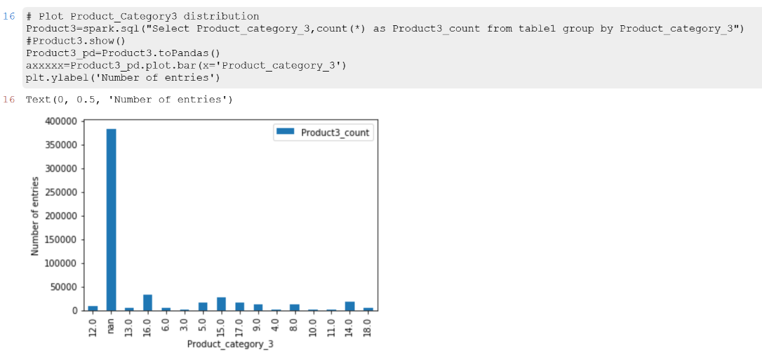
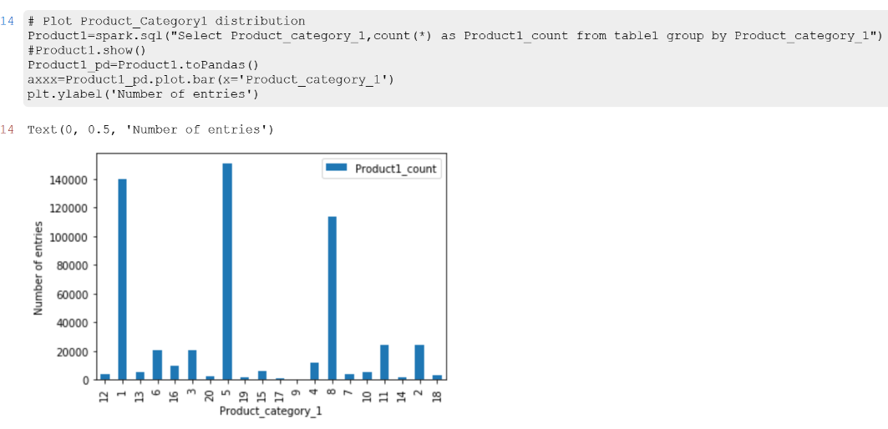

Slide 7
APPROACH
ETL – Load data from s3 storage
Create training and testing data
Setup a logistic regression model
Fit the model on our data
Find the predictions
Find predicted amount that maximum number of customer would pay for every product and display the conclusions found.

Slide 8
Sample Code

Slide 9
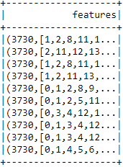
Vectorisation of features
data = spark.read.format("csv")\
.option("header","true")\
.option("inferSchema", "true")\
.load("E:\#Notes and Study Stuff\PBDA\Final Project\data\\pbda_train.csv")
df = data
merged = F.udf(lambda a,b,c,d,e,f,g,h,i,j,k: 'a'+str(a)+' b'+str(b)+' c'+str(c)+' d'+str(d)+' e'+str(e)+' f'+str(f)+' g'+str(g)+' h'+str(h)+' i'+str(i)+' j'+str(j)+' k'+str(k))
df = df.withColumn('X',merged(df['Age_label'], df['Gender'], df['Occupation'], df['Product_ID'], df['City_Category'], df['stay_in_label'], df['Stay_In_Current_City_Years'], df['Marital_Status'], df['Product_Category_1’], df['Product_Category_2’], df['Product_Category_3’]))

Slide 10
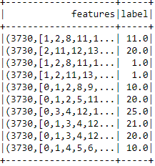
Assigning labels
#REDUCING NO OF LABELS BY PUTTING PRICE INTO BUCKETS
from pyspark.ml.feature import StringIndexer
from pyspark.sql.types import IntegerType
from pyspark.sql.types import FloatType
df = df.withColumn('labelCategory',((df['label']/750). cast(IntegerType())).cast(FloatType()))
dfFinal = df.select('features','labelCategory') \
.withColumnRenamed('labelCategory','label')

Slide 11
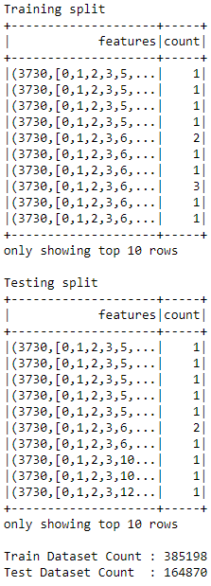
Training and Testing Data
(trainData, testData) = dfFinal.randomSplit([0.7, 0.3], seed = 888)
print('Training split')
trainData.groupBy('features').count().show(10)
print('Testing split')
testData.groupBy('features').count().show(10)
print('Train Dataset Count : ' + str(trainData.count()))
print('Test Dataset Count : ' + str(testData.count()))

Slide 12
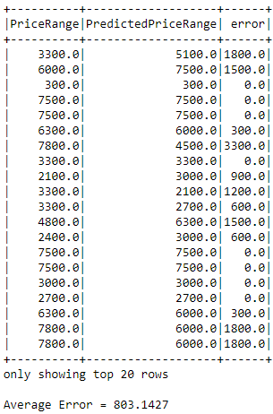
Original Data V/S Predicted Data
dfPredicted = dfPredicted.withColumn('error', abs(((dfPredicted['PriceRange']) - dfPredicted['PredictedPriceRange’] )))
dfPredicted.select(['PriceRange','PredictedPriceRange','error']).show()
statistics = dfPredicted.select('error').summary()
err = statistics.collect()[1]['error']
print('Average Error = %0.4f'%(float(err)))
statistics.show()

Slide 13
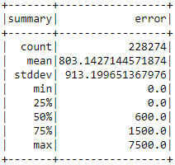
Predicted Data Analysis

Slide 14
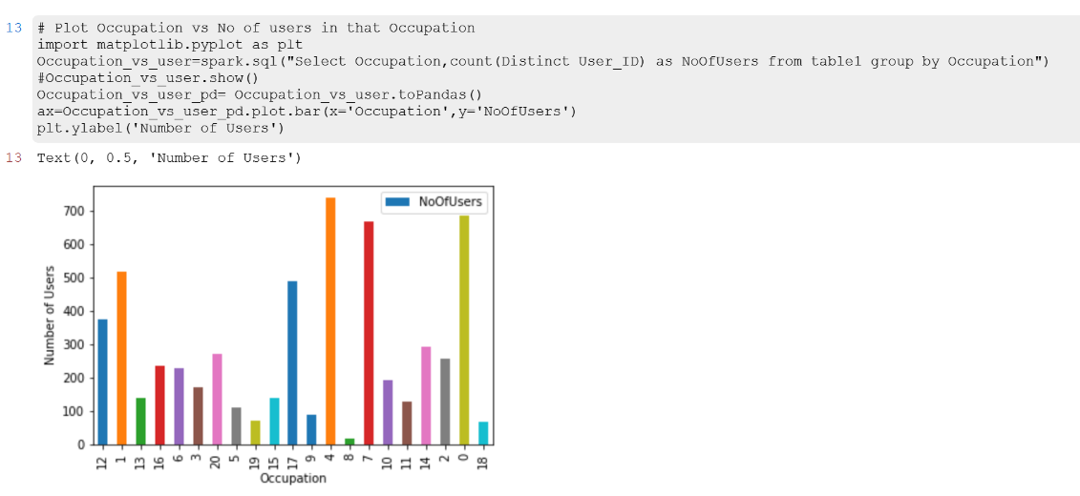
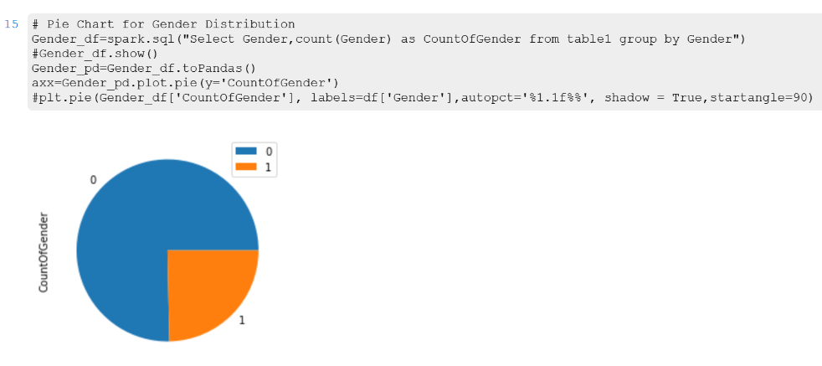
Data Analysis We observed that majority number of people belong to the 4th category of occupation also majority shoppers are male. Shopkeeper can target these customers for more sales

Slide 15
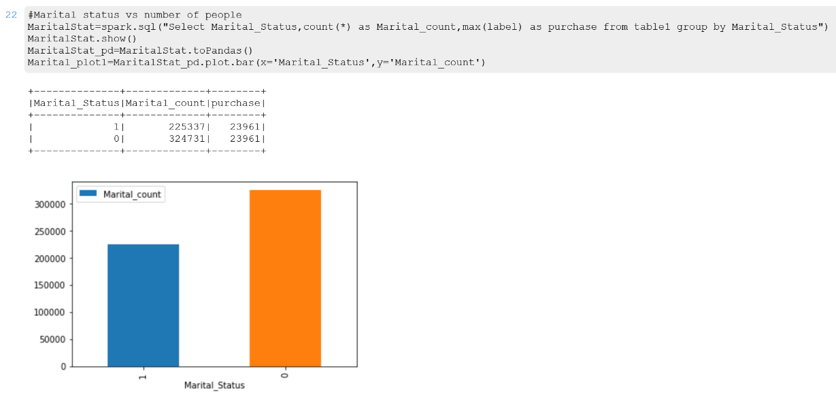
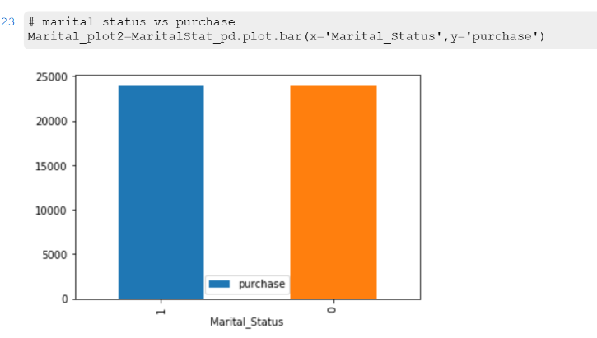
Data Analysis We observed that no.of married people are more but both married and unmarried people spend almost equal amount.We can infer that unmarried individuals spend more amount. Shopkeeper can target products bought by unmarried people more than the products bought by later.

Slide 16
And finally......

Slide 17
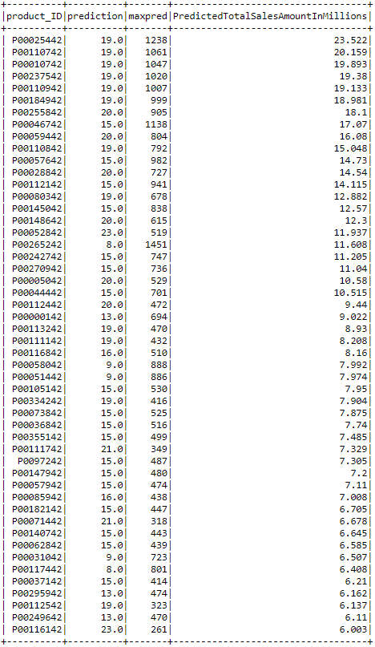
Estimated sales for black friday Calculate the popular predicted price point for every product from our data. Assuming that we select this obtained price for that particular product we will calculate the total sales for every product in the data.

Slide 18
Thank you!

